Slide 1
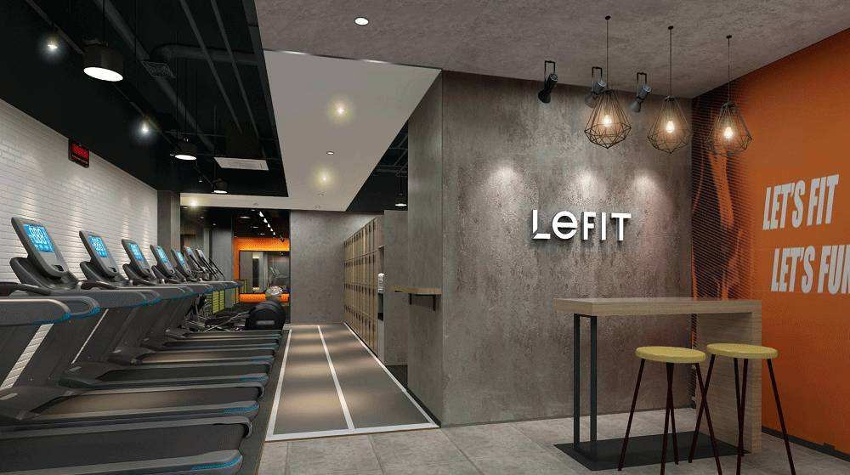

2020 Bain Cup Case Competition
The Transformation Strategy of LEFIT
We are the
INSIGHTers
Read our report

Slide 2
Agenda
Analysis
Overall Fitness Market
Specialty Fitness
Competitive Landscape
Key Trends
Customer Analysis
Strategy
Customer Relationship Management
Store Expansion
Industry Cooperation
Implementation Timeline
2

Slide 3
Executive Summary: LEFIT can achieve high future growth by employing transformation strategy, keeping up with 3 key trends in the industry
Decision
Stages
1 Analysis
2 Strategy
3 Implementation
Analyzing
Dimensions
Overall Fitness Market
Growing rapidly
Key drivers
Specialty Fitness
80’s and 90’s; Preference
Competitive Landscape
Key Trends
CRM
Store expansion
Industry cooperation
Customer Analysis
CRM Improvement
Construct a new O2O model
Introduce elements
Improve the quality of courses
Store Expansion
Adopt differentiated layout
Seek B2B cooperation
Industry Cooperation
Cooperate with upstream
Cooperate with downstream
Cooperate with competitors
Short Term
Long Term
Achieve High Future Growth in Specialty Fitness Market
3

Slide 4
Analysis: Overall Fitness Market >> Strategy >> Implementation Timeline
Overall Fitness Market: Rapid growth of overall fitness market is expected in the foreseeable future led by the drivers in social and economic dimensions
1
Overall fitness market is growing rapidly
2
The driving effect of PCDI, etc. on overall fitness market
Overall fitness market size in China (￥ 100 million)
Healthcare (￥1000)
Historical
Forecast
CAGR
15-19
CAGR
19-23
2023E
+20.6%
2021E
2019
20.6%
17.6%
2015
2017
PCDI (￥1000)
Increasing PCDI improves living standard, generating stronger incentives for customers to pay for fitness programs (Key Driver)
2015
2016
2017
2018
2019
2020E
2021E
2022E
2023E
2024E
Other
Drivers
Increased health awareness
The forecast CAGR is quite close to the historical CAGR, showing that the market growth has the tendency to keep high
China’s overall fitness market still has very high growth potential, including rapid increase in the number of gyms and emerging new forms of business
Western cultural influences
National policy incentives
Ongoing urbanization
Source: Literature Research; INSIGHTers Analysis Note: PCDI means Per-capita Disposable Income
4

Slide 5

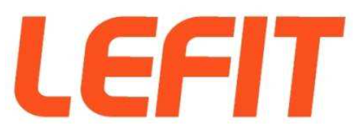


Analysis: Specialty Fitness >> Strategy >> Implementation Timeline
Specialty Fitness: Specialty fitness gyms can effectively tackle traditional pain points for potential fitness novices, ready to enter the period of fast-development
1
Fitness novices become mainstay of fitness market
2
3 main pain points for novices and corresponding solutions
Pain Points
Corresponding Solutions
Novices
Try & Experience
16.7%
High one-time cost
Monthly Card & Single Payment
Basic start
50.7%
Learning
Process
Novices
Difficult for novices
Enhance novice engagement
Advanced training
26.7%
Distance
Community-focused distribution
Others
5.9%
Against the backdrop of expanding fitness market, junior fitness novices become mainstay (over 65% of market share)
Traditional Gym
Specialty Fitness
Specialty fitness can effectively tackle traditional pain points for novices
3
Specialty fitness is about to enter the period of fast-development
Market recognition
Exploration Stage
(2012-2015)
Set-up Stage
(2016-2019)
Fast-development Stage
(2020-2025)
Maturation Stage
(2025-)
Beginning in 2012, the development of specialty fitness includes 4 stages:
Exploration stage: Shared fitness cabin(2013), Fitness container(2014)
Set-up stage: Internet gym(2016), branding and unique style of group lessons(2017)
Fast-development stage
Maturation stage
Historical
Forecast
Key logic: Utilize distribution breadth and enhanced engagement to attract more potential fitness novices
Source: Expert Interview; Literature Research; INSIGHTers Analysis
5

Slide 6





Analysis: Competitive Landscape >> Strategy >> Implementation Timeline
Competitive Landscape: The specialty fitness market is led by 4 companies with differentiated key characteristics
1
Top players gradually take the bulk of specialty fitness
2
Competitive landscape analysis: Rivalry plays a vital role
Number of specialty fitness gyms
Threat of New Entrants**
Historical
Forecast
3,990
Bargaining Power of Suppliers*
Rivalry****
Bargaining Power of Buyers**
Super Monkey
2,730
Substitutes*
Sunpig
3
Rivalry perspective: Competitive strengths and weaknesses
+97.6%
1,840
High-quality PGC
1,140
Smart Fitness
850
LEFIT
O2O & App
292
Platform Model
2016
2017
2018
2020E
2022E
2024E
The specialty fitness market is dominated by 3 major players (by number), which take up over 60% market share
Keepland is both a profitable single store and a billboard with content, from an app to a showcase of outcomes, while its offline size is not so large as the 3 major players (we still place Keepland on the list of top players)
LEFIT’s overall performance is strong in price advantage but weak in group class*, online content* and gym environment***
Source: Expert Interview; Literature Research; INSIGHTers Analysis
6

Slide 7
Analysis: Key Trends >> Strategy >> Implementation Timeline
Key Trend 1: Specialty fitness competitors are focusing more on customer relationship management (CRM), while LEFIT is lagging behind
LEFIT has low payment cycle
LEFIT is lagging behind its main competitors in per capita repurchase rate
1
2
LEFIT
Sunpig
Keepland
Average Payment Cycle
Traditional gym
Supermonkey
Time
Traditional gym
2019
Sunpig
2018
Keepland
2017
Supermonkey
2016
Per capita repurchase rate
LEFIT
1
2
3
1
2
3
1
2
3
Low
Mid
High
Shorter payment cycle needs higher customer repurchase frequency for stores to operate
Major problem of LEFIT:
Low customer stickiness, which indicates that LEFIT has poor CRM
Multiple competitors have witnessed increases in
repurchase rates, while LEFIT seems to be slightly behind
The key trend in specialty fitness market
is to increase customer stickiness
LEFIT’s customer stickiness is comparatively lower than its main competitors (Sunpig, Keepland, Supermonkey)
Source: Expert Interview; Literature Research; INSIGHTers Analysis
7

Slide 8


Analysis: Key Trends >> Strategy >> Implementation Timeline
Key Trend 2: Specialty fitness grows at a significantly higher rate than traditional gyms
Key Trend 3: Industry chain cooperation has become a major trend of specialty fitness
1
Specialty fitness stores develop at a significantly higher rate
2
Cooperation between industries is a major trend
Number of specialty fitness stores
2016
Competitors
Upstream-downstream Cooperation
Traditional
Specialty
2019
640
640
640
150
150
140
130
Competitors
120
100
100
100
82
80
80
65
60
60
21
20
0
WILL’S
TERA WELLNESS
INGYM
LEGFIT
SUPER
SUNPIG
LEFIT’s competitors are enthusiastically improving their industry chain layout, building an upstream-downstream cooperation
Supermonkey: “Happy Exercise + Nutritious Meals”, cooperate with Wagas, Puma, Joinfit, Modernsky, etc.
Sunpig: “Beehive Alliance”, cooperate with Kismart, INT, SHUA, etc.
Growth Rate
58%
131%
25%
327%
186%
540%
In terms of store expansion, the growth rate of new gyms is significantly higher than that of traditional gyms due to attributes such as small size and low debt ratio
Source: Expert Interview; Literature Research; INSIGHTers Analysis
8

Slide 9









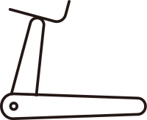


Analysis: Customer Analysis >> Strategy >> Implementation Timeline
Customer Analysis: To satisfy LEFIT’s target customers, LEFIT propose to provide universal, convenient, social and light fitness service
1
Profile of LEFIT’s primary target customers
3
Value proposition: Universal, convenient, social and light
Customer Profile
Value Proposition
Occupation
Others
Service industry
White-collar
Gains
Gain Creators
Education
Postgraduate
University
College
High School
Age
3%
2%
Purchasing
Criteria
Fitness Service
>44
35-44
25-34
18-24
<18
Pains
Income
5%
5%
Pain Relievers
>20k
10-20k
5-10k
3-5k
<3k
Criteria
Value Proposition
Profile: Well-educated, high-income, young, white-collar customers
Price
Universal to get
2
Key purchasing criteria of LEFIT’s primary target customers
Price
Convenience
Coaching
Socializing
Technology
Easiness
Convenience
Convenient, Accessible
Socializing
To meet social needs
Easiness
Simple and light training
Source: Expert Interview; Literature Research; INSIGHTers Analysis
9

Slide 10
Analysis >> Strategy: Strategy Overview >> Implementation Timeline
Strategy Overview
Current Situation
Key Trends
Key Strategy
1
LEFIT’s customer stickiness is comparatively lower than its main competitors
LEFIT has relatively poor CRM
Specialty fitness competitors are focusing more on CRM
boutique courses
Channel
Construct a new O2O model
Introduce social, competitive and novel elements
Create boutique courses and strengthen direct supervision
boutique courses
Service
CRM
2
LEFIT has opened > 500 stores up to 2018
LEFIT has high potential to expand store number in China’s fitness market
boutique courses
The scale of specialty fitness grows at a significantly higher rate
Adopt differentiated layout strategy, develop from TGI > 100 to TGI < 100
Seeking corporate partnerships with Internet enterprises, achieve B2B cooperation
Store
Store Expansion
3
LEFIT has tried to cooperate with corporates in other industries
LEFIT has high potential to carry out industry cooperation
Industry chain cooperation has become a major trend of specialty fitness
Cooperate with upstream corporates
Cooperate with downstream corporates
Cooperate with competitors
Even do mergers and acquisitions of KEEP!
Industry
Industry Cooperation
10

Slide 11



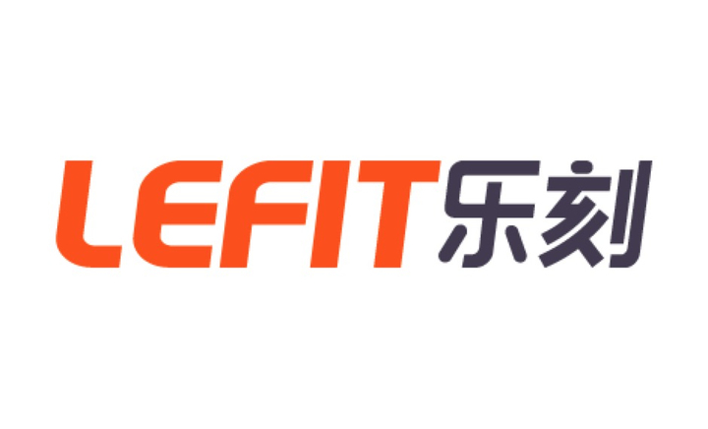
Analysis >> Strategy: CRM Improvement >> Implementation Timeline
CRM Improvement: A new O2O model concentrating more on online platform can be an excellent channel for LEFIT to acquire customers
1
Old customer acquiring model has its problems
3
LEFIT has great potential in O2O as an Internet company
High
Efficiency
High Coach
Concentration
Comparison
Low Cost
Technical Capability
Big Data
IoT
Information System
Online-to-offline drainage
Team Capability
Alibaba Marketing Director
CEO of Technology Group
✔
✔
✔
Corporate Capability
Internet Genes
Based on Hangzhou, O2O atmosphere
Traditional marketing
✘
✘
✘
LEFIT is currently behind its competitors in online construction
Strategies:
Use platforms such as Tik Tok, Kuaishou and Bilibili to transform some fitness coaches into Internet celebrities
Export company products and culture through online channels
Achieve reflow process through offline customer registration
KOL Construction, Building Online Brand Communities
2
Huawei mobile phone market downloads
Highest online sales of a single product
Comparison
500 million
Ten thousand level
Online:
App
3.1 million
One thousand level
Big Data
LEFIT can learn from its major competitors (e.g. Keepland) in online building
Also, LEFIT can cooperate with Keep to build complementary strengths and long-term cooperation relationship, even do mergers and acquisitions!
Customer
Reflow
Offline:
Stores
Source: Literature Research; INSIGHTers Analysis
11

Slide 12
Analysis >> Strategy: CRM Improvement >> Implementation Timeline
CRM Improvement: LEFIT should enhance social, competitive and novel elements of the course to meet customer preference
Specialty fitness customers value social elements
Specialty fitness customers favor competitive and novel elements
1
2
24 Hours allocations in one day
62%
In 24 hours a day,
people needs to meet their social need for 16% of the time
Applying to LEFIT, LEFIT customers attach great importance to the social functions of the gym
Among the top 7 interests of specialty fitness customers, e-sports and sports consist of ~50% (with a high TGI)
Self-improvement
Socializing
59%
Relaxing
57%
TGI=175
54%
Price, Convenience and Socializing
are their key purchasing criteria
TGI=167
47%
46%
Living
45%
Work
Socializing
Travel
Music
E-sports
Sports
Movies
Reading
Strategies:
Increase the proportion of group classes
Introduce more teamwork and group cooperation events into the courses
Enhance social elements of the online platform
More specifically: Organize regular team events, outdoor workouts, social parties, etc.
Strategies:
Introduce group competitions, ranked competitions, point rewards into the course
Introduce more competitive but easy-to-access sports events
More specifically: Through the smart bracelet, constantly monitor participants' heart rate, breathing, calories burned, etc., display ranking on the app or offline screen, and record the ranking
Source: Expert Interview; Literature Research; INSIGHTers Analysis Note: TGI means Target Group Index
12

Slide 13
Analysis >> Strategy: CRM Improvement >> Implementation Timeline
CRM Improvement: LEFIT should create more boutique courses, strengthen direct supervision of franchised stores to improve the quality of courses
1
LEFIT has more polarized customer ratings
3
LEFIT has weak supervision of its franchise stores
Strong Supervision
Weak Supervision
78%
Favorable
LEFIT
92%
Direct Mgt
Brand
Revenue
Franchise
Fee
LEFIT
Self-operated
Store
Franchised
Store
Moderate
Supermonkey
Select Gyms
Poor
Coach
Customer
LEFIT’s partnership system is weakly supervised, which puts franchise stores at greater moral hazard, thus gym quality varies greatly
2
LEFIT’s classes have lower quality with lower retention rate
Strategies:
Create more boutique courses and increase customer satisfaction with the courses
Optimize commission structure of franchised stores
Strengthen direct supervision and performance incentives for franchised stores
High-quality Courses
Customer Retention
Rate
57.9%
70.3%
Source: Expert Interview; Literature Research; INSIGHTers Analysis
13

Slide 14
Analysis >> Strategy: Store Expansion >> Implementation Timeline
Store Expansion: LEFIT should adopt differentiated layout strategy, including increasing customer stickiness in tier 1 & 2 cities and developing rural market in tier 3 & 4 cities
Tier 1 & 2 cities: Increase customer stickiness
Tier 3 & 4 cities: Develop rural market and seize market share
1
2
Customer Experience
BJ
Overall Market Size YoY
City with large
gym numbers
Tier 3 & 4 Market Size (￥100 million)
SH
Tier 1 & 2 Market Size (￥100 million)
Historical
Forecast
HZ
City with small
gym numbers
Note:
HZ: Hangzhou
SH: Shanghai
BJ: Beijing
Price
Currently, the main layout of LEFIT is in Shanghai, Beijing and Hangzhou
LEFIT only operates stores in tier 1 and 2 cities, and mainly at the core of the cities
Customers in tier 1 and 2 cities focus more on customer experience and market saturation is high
2015
2016
2017
2018
2019
2021E
2023E
Fitness awareness increases while coverage rate in tier 3 and 4 cities is still in its infancy
The market potential is huge and the number of gyms is far from saturated, so LEFIT has high new store opening potential
Tier 1 & 2
Improve existing layout
Enhance customer experience
Strategy: Differentiated Layout
Open up rural market
Increase gym number
Tier 3 & 4
Source: Expert Interview; Literature Research; INSIGHTers Analysis
14

Slide 15







Analysis >> Strategy: Store Expansion >> Implementation Timeline
Store Expansion: Adopting B2B model and seeking corporate partnerships with Internet enterprises will become a new possibility for store expansion
Internet employees have a high demand for fitness
The welfare provision of physical activity is the most popular
1
2
The demand for fitness has increased due to the fact
that few employees are now engaged in physical work
Corporate Health Management Initiatives
Exist
Planning
Not yet
Entry-level
Expert
Unwilling
Health Mgt Plan
Corporate
fitness gym
Willingness
to get fit
Among corporate health management initiatives: the provision of physical activity benefits ranks first
Advantages of cooperation with Internet enterprises
Compared with corporates in other industries:
Internet enterprises value employee welfare and invest heavily in fitness and other related businesses
Employees in Internet enterprises mostly are the target customers of LEFIT (match LEFIT’s customer profile)
Employees are open-minded, keep up with the times and easily accept new things
Strategies of cooperation with Internet enterprises:
Build corporate gyms
Provide health management plans
Offer discounted
fitness cards
Conduct corporate group-building events
Source: Literature Research; INSIGHTers Analysis
15

Slide 16
Analysis >> Strategy: Store Expansion >> Implementation Timeline
Store Expansion: The number of specialty gym stores will grow steadily over the next 5 years and LEFIT can unlock market potential by seizing KSFs, adding > 1000 stores
1
Key Success Factor 1: Develop from TGI > 100 to TGI < 100
3
LEFIT can unlock new store opening potential by seizing KSFs
The key success factor for LEFIT to expand is to start from cities where TGI > 100 and gradually spread to cities where TGI < 100
Small
Size
Low
Debt Ratio
Low Set-up Cost
Low
Risk
Comparison
Specialty fitness
✔
✔
✔
✔
Traditional fitness
✘
✘
✘
✘
Year | Additional number of specialty fitness | Additional number of B2B LEFIT | Additional number of LEFIT (except B2B) | Additional number of LEFIT (All)
2020E | 360 | 20 | 140 | 160
2021E | 350 | 40 | 150 | 190
2022E | 400 | 50 | 170 | 220
2023E | 430 | 80 | 160 | 240
2024E | 440 | 90 | 170 | 260
TGI < 100
TGI > 100
2
Key Success Factor 2: Achieve B2B cooperation
Build Platform
B2B Cooperation
In the next five years, the number of gyms in LEFIT is expected to exceed 1000, tripling the current overall size
Employee Fitness Program
Source: Literature Research; INSIGHTers Analysis Note: TGI means Target Group Index
16

Slide 17

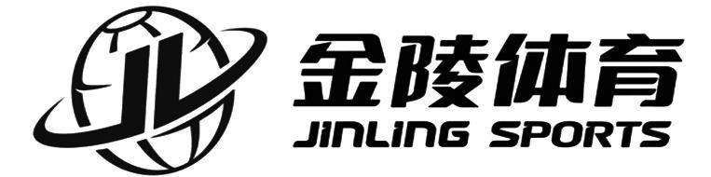
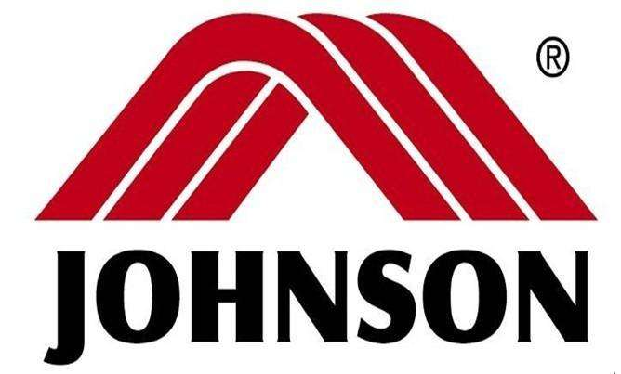

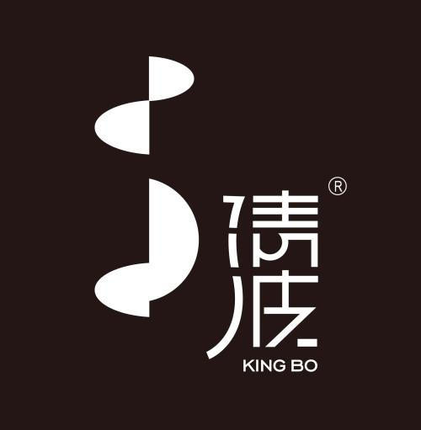




Analysis >> Strategy: Industry Cooperation >> Implementation Timeline
Industry Cooperation: LEFIT can cooperate with corporates upstream and downstream of the industry chain, or even competitors in the same industry
1
The current industry chain of fitness market
2
LEFIT can cooperate with corporates in 3 dimensions
Upstream
Midstream
Downstream
Apparatus
Competitor
Apparatus
Competitor
Individual or Corporate
Coach Training
Provide fitness service
Corporate
Industry Competition
Clothing
Manufacturer
Coach Training
Courses
Light Food
Manufacturer
Our recommended cooperation landscape for LEFIT
Related Service
Upstream Cooperation
Downstream Cooperation
A
B
C
Competitor Cooperation (e.g. Keep)
Apparatus:
Produce fitness equipment with LEFIT logo
Direct sales of equipment at shopping festival to drive sales
As a content exporter, load LEFIT’s own boutique content on the fitness equipment
Coach Training:
Develop rating system for coaches
Conduct regular coach training
Find talents in sports schools
Clothing Manufacturer:
Co-logos and brand cooperation
Light Food Manufacturer:
Sell or send light meals wholesale from manufacturers
Comparison:
Keep’s offline stores are weak but online market are vast; while LEFIT invested by Alibaba has strong Internet genes
Strategy:
Build complementary strengths and long cooperation relationship, even do mergers and acquisitions!
Corporate:
Build corporate gyms
Provide health management plans
Offer discounted fitness cards
Conduct corporate group-building events
Source: Literature Research; INSIGHTers Analysis
17

Slide 18
Analysis >> Strategy >> Implementation Timeline
Strategy Implementation Timeline
Short-term Strategy
Long-term Strategy
2020
2021
2022
2023
2024
1
Customer Relationship Management
O2O model Construction
Courses enhancement
Supervision strengthening
2
Store Expansion
Customer Stickiness Cultivation
Rural Market Development
B2B Model Adoption
Corporate partnerships
3
Industry Cooperation
Upstream Cooperation
Downstream Cooperation
Competitor Cooperation
18

